Slide 1
Cambridge
IGCSE
Computer Science
Section 1
Binary systems
Unit 1: Data representation
1

Slide 2
Objectives
Define the terms bit, nibble, byte, kilobyte, megabyte, gigabyte, terabyte
Understand that data needs to be converted into a binary format to be processed by a computer
Convert positive denary whole numbers into 8-bit or 16-bit binary numbers and vice versa
explain the use of binary codes in computer registers

Slide 3

What is this symbol? Why?

Slide 4
What language Computer understand?
English
Chinese
Japanese
Hindi
Other ????????
– Binary language

Slide 5

Understanding binary
Computers understand only two things: power on, or power off
This is represented by switches, and computers are essentially calculators made up of billions of switches
Power on = 1
Power off = 0
Everything that a computer needs to process must be converted into a binary format
This format is used for storing numbers, text, images, sound and program instructions

Slide 6
Binary number system
In electronics, binary numbers are the flow of information in the form of zeros and ones used by digital systems.

Slide 7
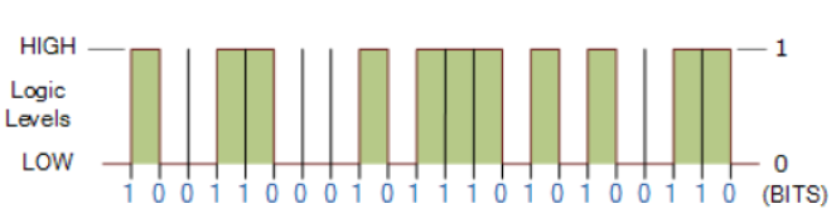
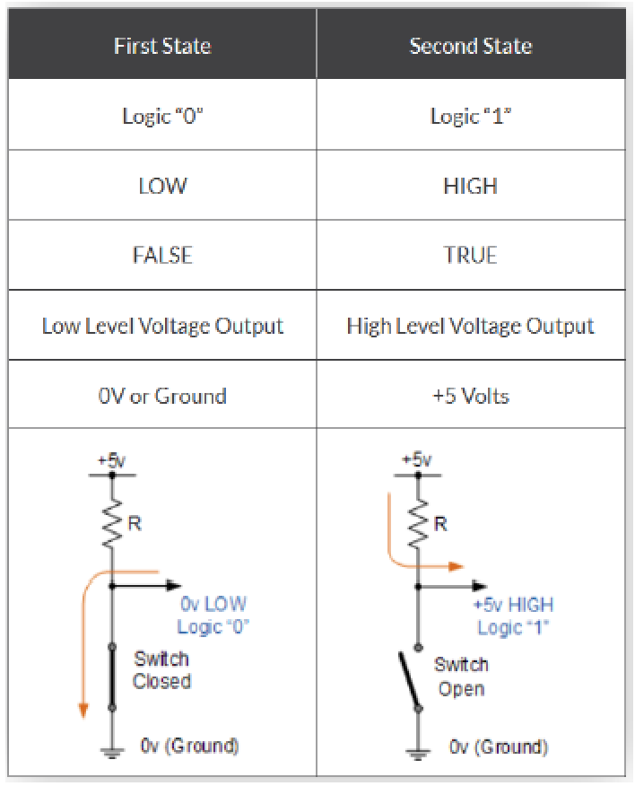

Slide 8
Bits and bytes
1 bit = a single 0 or 1
1 byte = 8 bits = 1 character of text
(A nibble = 4 bits or half a byte)
1 KB = 1024 bytes
1 MB = 1024 KB or 1024 x 1024 bytes
1 GB = 1024 MB
1 TB = 1024 GB
What comes next? How many TB?

Slide 9
Gigabytes and Gibibytes
The term gigabyte (GB) is used to refer to 1,073,741,824 or 1024³ bytes
Confusingly, it is sometimes also used to refer to 1,000,000,000 (1 billion) bytes
E.g. the capacity of a 128 GB disk is 128 billion bytes
The prefixes kibi, mebi, gibi were coined in an attempt to reduce this confusion
In this notation, 1 KiB = 1024 bytes and 1 KB = 1000 bytes
In this course you will use the older notation in calculations, so 1 GB = 1024 MB or 2³⁰ bytes

Slide 10
A sense of scale
File | Size
One character of text | 1 byte
A full page of text | 30 KB
One small digital colour photograph | 3 MB
Music CD | 600 MB
A DVD | 4.5 GB
Hard disk | 1 TB

Slide 11
Worksheet 1
Complete Task 1

Slide 12
Binary representation
Number of Switches (Bits) | Possible combinations or states
1 | 2
2 | 4
3
4
5
6
7
8

Slide 13
Binary representation
Number of Switches (Bits) | Possible combinations or states
1 | 2
2 | 4
3 | 8
4 | 16
5 | 32
6 | 64
7 | 128
8 | 256

Slide 14

Binary and denary number systems
Denary is a Base 10 number system with 10 digits 0-9
Why 10 digits?
Binary is a Base-2 number system with 2 digits, 0 and 1

Slide 15
Numbers with the denary system
Thousands, Hundreds, Tens and Units
1000 |  | 100 |  | 10 |  | 0
2 |  | 7 |  | 0 |  | 3
2x1000 | + | 7x100 | + | 0x10 | + | 3x1 | = 2703

Slide 16
Convert (10010110) to decimal number.
128 | 64 | 32 | 16 | 8 | 4 | 2 | 1
1 | 0 | 0 | 1 | 0 | 1 | 1 | 0
1x128 | + |  | 1x16 | + | 1x4 + 1x2 |  | = ?

Slide 17
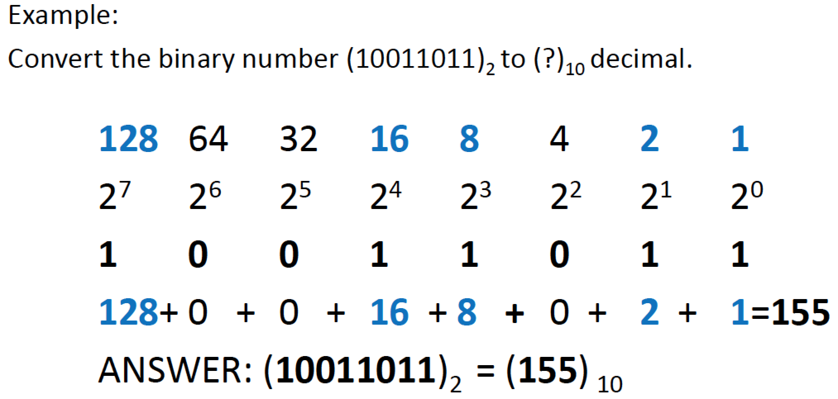


Slide 18
Convert (00111001) to decimal number.
What is:
128 | 64 | 32 | 16 | 8 | 4 | 2 | 1
0 | 0 | 1 | 1 | 1 | 0 | 0 | 1

Slide 19
Worksheet 1
Complete Task 2

Slide 20
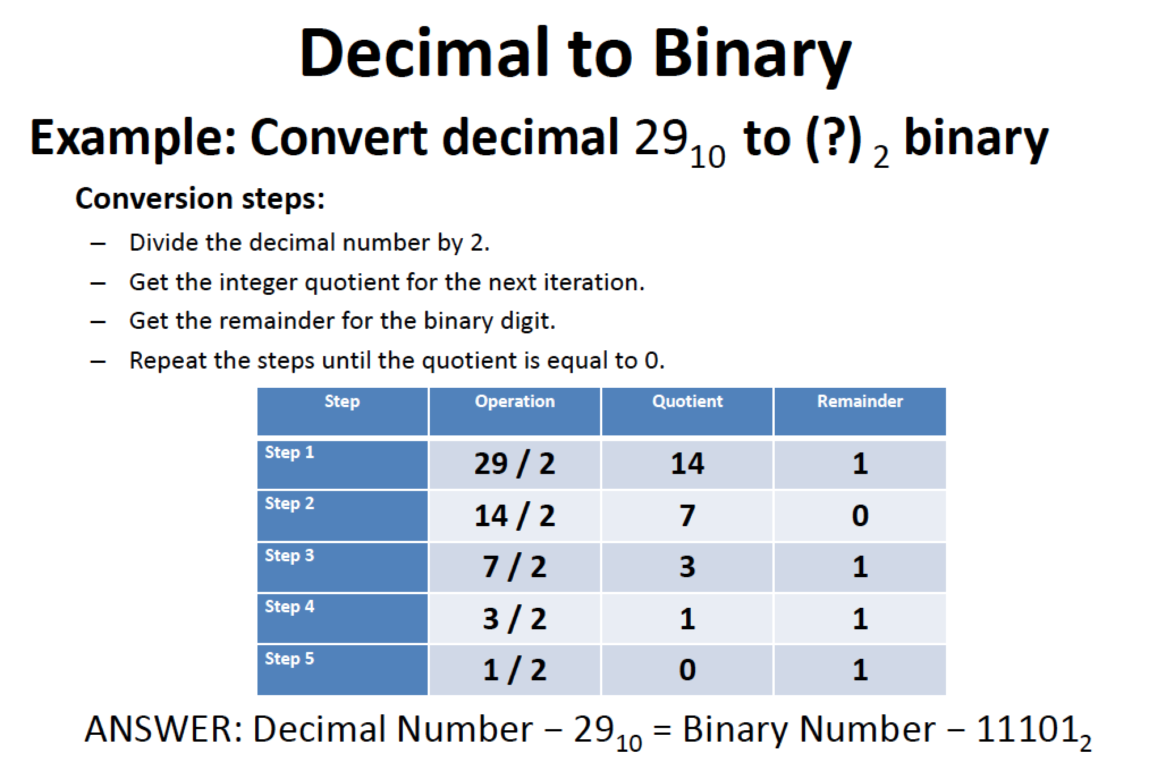

Slide 21
Worksheet 1
Now complete Task 3 and 4

Slide 22
Representing large integers
You have seen how to represent the numbers 0-255 in binary, in a single byte (8 bits)
255 = 2⁸ – 1
What is the largest number that can be held in 16 bits?
65,536

Slide 23
Representing large integers
Computers used to use 2 bytes to represent an integer
Nowadays, they mostly use 4 or more bytes
What is the largest integer that can be represented
in 2 bytes?
in 4 bytes?
(Answers in the format 2^{n} - 1 please!)

Slide 24
Using 16 bits
The eight most significant bit place values:
The technique for conversion is identical to that used with only eight bits
32,768 | 16,384 | 8,192 | 4,096 | 2,048 | 1,024 | 512 | 256 | 128
0 | 1 | 0 | 1 | 1 | 0 | 0 | 1 | 0

Slide 25
Worksheet 1
Now complete Task 5

Slide 26
Computer registers
A computer register is a small, but very fast piece of memory
It can have 8, 16 or 32 bits
All calculations done by the computer are carried out in registers

Slide 27
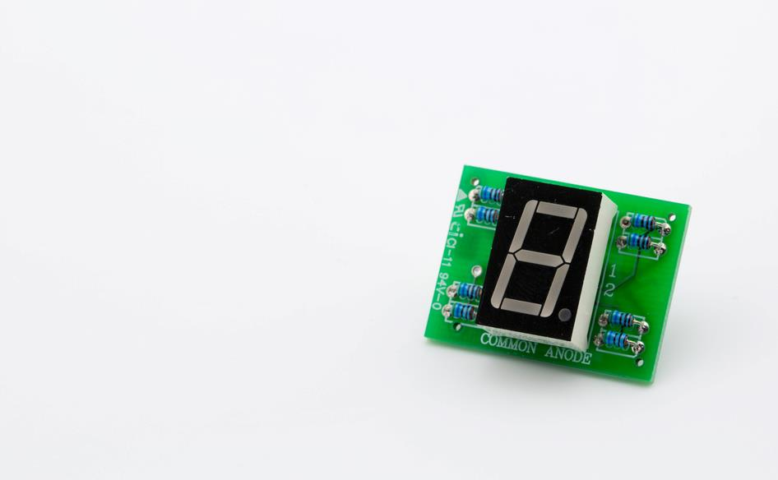
Digital displays
A standard numeric display uses 7 (or 8) segments
Each segment is given a binary value
Based on the binary values, lights are switched on or off to create a recognisable number

Slide 28
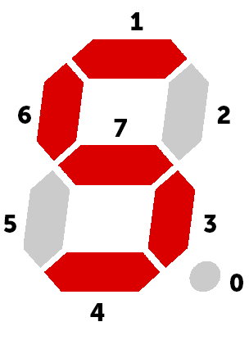
Binary in digital displays
A register of 8 bits is used to store and determine the state of each segment (including the decimal point - 0)
What number would be represented if the register value was 11001100?
Display Register
7 | 6 | 5 | 4 | 3 | 2 | 1 | 0
1 | 1 | 0 | 1 | 1 | 0 | 1 | 0

Slide 29
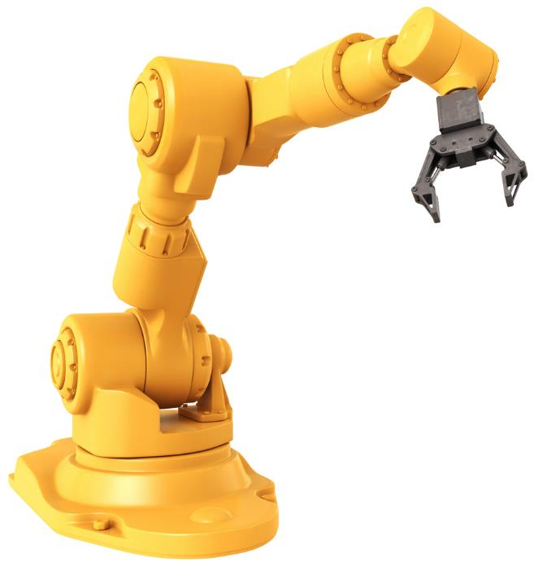
Registers in industry
Registers can also be used to hold the state of a machine
A robotic arm may have eight possible movements
The register values below extend and lower the arm whilst opening the claw
Rotate left | Rotate right | Open claw | Close claw | Extend arm | Retract arm | Raise arm | Lower arm
0 | 0 | 1 | 0 | 1 | 0 | 0 | 1

Slide 30
Plenary
For your exam you need to be able to:
explain why computers use binary to represent any kind of data
give examples of the different types of data that computers can hold
convert numbers 0-65,535 to binary and vice versa
define bit, byte, kilobyte, megabyte, gigabyte, terabyte
understand how registers are used in applications

